Slide 1
Sustaining a Global Society:
Languages of the Wider World
Indonesian and Malay for accessing
Islamic Cultures in
Southeast Asia
Teresa Birks, SOAS
29th March 2012
Notes:
I’m Teresa and I’m currently teaching Indonesian language and literature here at SOAS. I don’t have a background in Islamic Studies, though much of my work in Indonesia and Malaysia has been with predominantly – and sometimes exclusively – Islamic communities.
This presentation has two aims:
The first to try and encourage more people to take up the study of Indonesian and Malay, particularly those with a background and interest in Islamic Studies. There are many opportunities for the study of Islamic Cultures in Southeast Asia, yet it remains the case that few of those who do so have a sold grounding in Islamic Studies - with the exception of course of students from Southeast Asia in general and countries such as Indonesia and Malaysia in particular. There are a number of reasons for this, including I suggest the perception of Islam in Indonesia as somehow ‘syncretic’ and thus not ‘authentic’.
The second aim is to look at where Indonesian and Malay is taught – access to the study of the languages is as important as the languages are to accessing Islamic Cultures in Southeast Asia. Is the study of these languages thriving? What has influenced the uptake of these languages?
I will begin by saying something about the languages themselves, and at the end of the presentation I have added a few slides that include relevant courses of study currently available at SOAS and a link to the Asia Society’s excellent resources for the introduction to the study of Islam in Southeast Asia.
It is inevitable of course that in such a brief presentation many generalisations will be made, and much of the data disputable, not least by me… I hope however that the data and information cited will nevertheless succeed in providing a sense of the importance of Indonesian and Malay, particularly for accessing Islamic Cultures in Southeast Asia.
I would also like to thank the LLAS and the Islamic Studies Network for inviting me to present this paper, and to colleagues at SOAS, particularly Dr Ben Murtagh and Dr Kostas Retsikas, as well as Professor Bill Watson (University of Canterbury) who helped me give shape to the presentation. I am of course responsible for the presentation itself and any errors etc. are entirely my own.

Slide 2
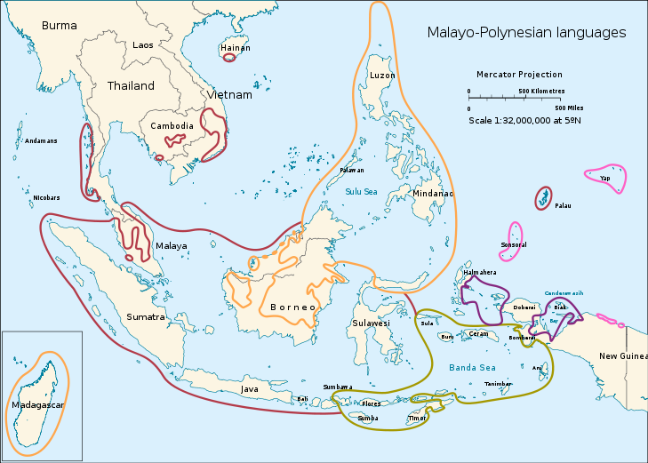
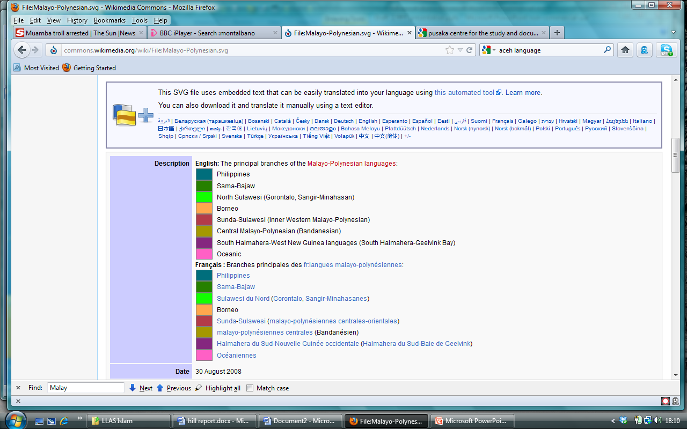
Malayo-Polynesian languages in SE Asia
Notes:
First of all, a map of Southeast Asia which stretches from Burma in the west round to Thailand, Laos, Vietnam and Cambodia, down to Malaysia and Singapore, to Indonesia which stretches all the way east to the western half of the island of New Guinea, taking in Timor Leste to the south and Brunei on the north coast of the Island of Borneo, taking us up to the Philippines.

Slide 3
Linguistic context
Austronesian (Malayo-Polynesian) languages
Indonesian a form of Malay – oral tradition
Malay a lingua franca from circa 1300 CE
Associated with the spread of Islam (early 14th century)
Islam and Arabic script disseminate language further, faster
Many words from Arabic, especially terms referring to aspects of worship and Islamic jurisprudence
National languages of Indonesia, Malaysia, Brunei & Singapore
6th most widely spoken language – circa 250 million
Circa 40 million mother tongue speakers
Now predominantly written in roman script
Closely related to local languages of Islamic communities e.g. Kelantanese (Malaysia), Minangkabau (Indonesia), Yawi (Thailand)
Notes:
Indonesian and Malay are Malayo-Polynesian languages (Western Branch) and Indonesian is a form of Malay. Although the Malay heartland is located in Sumatra and peninsular Malaysia, the language became the lingua franca or trade language of the region from the early 1300s, well placed on the trade routes between the Middle East and South Asia and China. As well as the language of trade, Malay was also the language of the spread of Islam in much of the region, maritime Southeast Asia in particular. Malay was an oral language, and Islam brought with it the Arabic script, which in turn served to spread the use of Malay as the lingua franca further and faster. Indeed there are many Arabic loan words in Malay and Indonesian, especially terms used in worship and jurisprudence.
It was Malay’s role as lingua franca which led the Dutch use it as the language of administration in the Dutch East Indies, and which in turn enabled its adoption as the national language of an independent Indonesia by young nationalists in 1928. Today Indonesian and Malay are the national languages of Indonesia, Malaysia and Brunei as well as one of four official languages of Singapore (the national anthem is in Malay). It is now almost exclusively written using the roman alphabet, though the internet has given the use of the Arabic or jawi script a new lease of life in Malaysia in particular (especially in the states of Kelantan, Terengganu and Johor), and you can see its use on some street signs too.
Although Indonesian is a form of Malay, there are by now many differences, lexically and syntactically, although the study of one facilitates the study of the other, and they also have a shared history and cultural legacy, particularly with reference to classical Malay literature. So we take the two languages together, there are an estimated 250 million speakers of Indonesian and Malay in the region – around 47% of the Southeast Asian population, which also makes it, according to some estimates, the sixth most widely spoken language globally.

Slide 4
Religious and cultural context
Vietnam & Cambodia – oldest textual history, Kufic inscriptions from 1035 CE (Vietnam)
Earliest conversion of a Malay ruler c.1280 CE – spread of Islam early 14th century, beyond elite sphere early 17th century
215 million people or 40% of SE Asia’s population Muslim
Indonesia has world’s largest Muslim population (190 million)
Official religion of Malaysia (for Malays) and Brunei
Muslim communities in Singapore (15%), Philippines (5-9%), Thailand (4.6%), Burma (4%)in Cambodia (2-5%), Vietnam (0.1%)
Notes:
Turning to the religious and cultural context, it is largely accepted that Vietnam and Cambodia have the oldest textual history of Islam in Southeast Asia, with Kufic inscriptions dating from around 1035 CE in Vietnam. There is evidence of Muslim traders travelling to e.g. Sumatera as early as to 8th, though the earliest conversion of a Malay ruler to Islam is estimated to have taken place in around 1280 CE (Russell Jones: http://www.ottomansoutheastasia.org/ottoman-watermarks-in-malay-manuscripts.php accessed 27/4/12), with the spread of Islam really gathering momentum in the late 13th/early 14th century and then spreading beyond the elite sphere in the early 17th century.
Today around 215 million people or 40 percent of Southeast Asia’s population are Muslim and Indonesia has the world’s largest Muslim population at around 190 million people (80%). It is the official religion of Malaysia (for Malays) and of Brunei, and Islamic Law or Shari’a has been adopted in regions of Indonesia such as Aceh and Malaysia such as Kelantan.

Slide 5
Islam in Southeast Asia http://sites.asiasociety.org/education/islam_in_seasia/images/maps/11SEAsiaReligions.pdf
Notes:
And if we take a look at a linguistic map and a map of religions of Southeast Asia side by side, you can see there is a strong relationship between them. It should of course be noted that there are literally hundreds of languages spoken in Southeast Asia, with anything between 200-600 languages estimated to be spoken in Indonesia alone, depending on the definition of a language. Nevertheless it remains possible for us to assert Indonesian and Malay remain the dominant languages of the Islamic world in Southeast Asia.

Slide 6
Characterizing Islam in SE Asia…
“Islamic communities of SE Asia are diverse, complex and increasingly influential in the broader Islamic world. However, the extraordinary breadth of practices and norms across the Muslim world is not widely understood outside the region – often because of the difficulty of locating and putting into context the material produced by Muslims themselves”
Back cover, Fealy G & Hooker, V. Voices of Islam in Southeast Asia: A Contemporary Source Book (2006) ISEAS Singapore
Notes:
So how can we characterise Islam in Southeast Asia – is it possible to do so? I quote here from Greg Fealy and Victoria Hooker in the introduction to their sourcebook, Voices of Islam in Southeast Asia, Islamic communities of Southeast Asia because they encapsulate a number of key points that I would like to make.
First, that Islamic communities in Southeast Asia are diverse and complex; second, that they are increasingly influential in the broader Islamic world and thirdly, that the breadth of practices and norms are not widely understood outside the region.
I highlight the last sentence last because it emphasises the importance of locating and contextualising materials produce by Southeast Asian Muslims themselves – and thus the important role of language has to play in facilitating access not only to the materials produced by Southeast Asian Muslims, but Southeast Asian Islamic communities themselves.

Slide 7
Role of the vernacular in
Islamic Cultures of SE Asia
As noted by Fealy and Hooker:
Most Southeast Asian Muslims learn about Islam through their own vernaculars
Vernacular acts as a bridge between original sources and contemporary faithful
Arabic terms transferred from the Arabic script to the vernacular
Languages of Islam in SE Asia numerous and diverse
Richness of SE Asian Islam is expressed in local languages
p.2 Fealy G & Hooker, V. Voices of Islam in Southeast Asia: A Contemporary Source Book (2006) ISEAS Singapore
Notes:
Indeed Fealy and Hooker go on to emphasise the importance of the vernacular in the study of Southeast Asian Islam. To paraphrase Fealy and Hooker, most Southeast Asian Muslims learn about Islam through their own vernaculars, which act as bridges between original sources and the contemporary faithful (with Arabic terms having transferred from the Arabic script to the vernacular). The languages of Islam in Southeast Asia are thus numerous and diverse and thus, Fealy and Hooker conclude, the richness of Southeast Asian Islam is expressed in local languages.
So clearly local languages are important to the study of Islamic cultures in Southeast Asia. Although many if not most will have learnt to recite the Qur’an, few Southeast Asian Muslims speak Arabic or have had the opportunity to study Islam in some depth. Neither do the majority speak English. And although there are many hundreds of languages in Southeast Asia, Indonesian and Malay play an important role in the facilitation of the study of Islamic cultures in Southeast Asia by virtue of the fact that they are not only the national languages, the languages of communication and the languages of study of so many Muslims in Southeast Asia as well as being the main languages of the dissemination of Islam in the first place.
Another more pragmatic reason for my focus on Malay and Indonesian relates to accessibility to the study of Southeast Asian languages. Although Javanese is, for example, a major language of Indonesia, particularly in relation to Islamic communities, there are even fewer places where we can study Javanese in Higher Education than there are for Indonesian and Malay. Indeed there is currently no HE in the UK which provides for the study of Javanese language.

Slide 8
Perceptions of Islam in SE Asia
Indonesia
“Because of the archipelago’s position in the Southeastern Indian ocean, far from the authentic Muslim lands of the Arab world, because of its Hindu-Buddhist cultural legacy, and because of the suppression of Muslim energies during the long period of Dutch colonial rule, Indonesian Muslim practice has often been characterized as impure syncretism”
Professor Anne Rasmussen – The Aesthetics of Arab Music, Language, and Performance in the Worlds of Indonesian Islam (abstract), presented at the World Congress for Middle Eastern Studies, Barcelona, 2010
http://www.smlc.religionmusic.leeds.ac.uk/assets/Islam%20in%20Performance%20Poster.pdf (accessed 18.3.12)
Notes:
As alluded to in my introduction, linguistic capacity isn’t the only challenge to promoting the study of Islamic cultures in Southeast Asia. There is also a problem of perception, namely that Southeast Asian Islam is somehow ‘impure’ and ‘unauthentic’.
I quote here from Professor Anne Rasmessen, an ethnomusicologist, speaking with reference to pious music in Indonesia at the World Congress for Middle Eastern Studies in Barcelona in 2010. I quote Rasmessen partly because she identifies one of the reasons why there is not more research being carried out on Islam in Southeast Asia by people with a background in Islamic Studies (other than people from Southeast Asia itself of course), as opposed to e.g. ‘Indonesianists’ or ‘Southeast Asianists’ as is more often the case. I also quote her because she says this at a conference attended by a diversity of experts in Middle Eastern studies, which for me further reinforces the notion that there is an issue regarding the perception of Islam in Southeast Asia amongst researchers and academics working in the more usual locus of Islamic Studies.
Taking SOAS as an example, notwithstanding the fact that we have programmes here at both undergraduate and postgraduate level that enable the combination of Islamic Studies with, for example, the study of Indonesian and other Southeast Asia-related courses, the only people to have taken that option up thus far have been students from Southeast Asia, and with the exception of one student from Thailand, specifically from Malaysia or Indonesia.
I should emphasise that what Rasmussen identifies and which I am echoing is the perception or charaterization of (in this case) Indonesian Muslim practices as ‘impure syncretism’. It is certainly not a characterization or perception which I (or clearly Rasumssen) share.
When I gave my presentation at SOAS, an academic from Malaysia pointed out that some of his colleagues from the Middle East were ‘surprised’ at the religious observance they saw in Malaysia (including prayer rooms at the Formula 1 racing circuit), and that he felt some of his Middle Eastern colleagues seemed to treat Malaysian Muslims as ‘recent converts’.

Slide 9
Increased influence in the Islamic world
“Key to Indonesian Islamic arts (…) are the aesthetics of Arabic language and music, which constitute a global aesthetic system that Indonesian artists both reference and resist depending on their cultural background and political orientation.
From seashore to department store the contexts and contents of Islamic music in Indonesia represents a vibrant and meaningful stream of Indonesian culture as well as an aspect of global Islam that is creative, dynamic and sophisticated”
Professor Anne Rasmussen – The Aesthetics of Arab Music, Language, and Performance in the Worlds of Indonesian Islam (abstract), presented at the World Congress for Middle Eastern Studies, Barcelona, 2010
http://www.smlc.religionmusic.leeds.ac.uk/assets/Islam%20in%20Performance%20Poster.pdf (accessed 18.3.12)
Notes:
And here I continue with Rasumssen, who goes on to emphasise Indonesian pious music as an aspect of global Islam and its relationship, both in terms of resisting and referencing the global aesthetic of Arabic language and music. In so doing she identifies just one of many potential areas for the study of Southeast Asian Islam in the wider global context that would benefit from the in-depth knowledge of scholars with a background in Islamic Studies, as well as the (here) Indonesian context, and thus broader Southeast Asian context.

Slide 10
Local vs Universal
“Since the 1980s there has been a consistent effort to move away from evaluating Islam in SE Asia according to norms found in the Arab world. This has been accompanied by parallel developments by Indonesian and Malaysian intellectuals that have attempted to draw a boundary between Islam and Arab culture in contestation of increasing numbers of people in Indonesia, the Philippines and Malaysia subscribing to a Middle Eastern sense of Islamic orthodoxy and abandoning practices deemed too 'local’. This 'battle' for the definition of Islamic orthodoxy and the question of what is local and what is universal in Islam continues to this day”
Dr Kostas Retsikas, ESRC research project, Cultivating Generosity: Islam, the ‘Gift Market’ and the Middle-Class in Indonesia, SOAS, email communication 16.3.12
Notes:
Here I continue by quoting Dr Kostas Ketsikas, an Anthropologist from SOAS, whose comment resonates with Rasumssen (previous slide), specifically with reference to both the reference and resistance to global Islam or Islamic norms found in the Arab world, echoing the sites of contestation and the ‘battle’ for the definition of Islamic orthodoxy and what is universal in Islam – again in my view extremely fruitful areas for further study and research by those with a background in Islamic Studies from outside of the Southeast Asian region as well as within it.

Slide 11
Research examples
Islam in contemporary SE Asia
National University of Singapore – International Centre for Aceh and Indian Ocean Studies (ICAIOS)
Islamic Law and Society project
Political changes in Aceh have created new dynamics in evolving local understandings of the interaction between Islamic religious norms, local cultural practices, and formal legal structures in the province.
Developing nuanced and comparative understandings of contemporary issues of Shari’a implementation in other Muslim societies.
http://www.ari.nus.edu.sg/article_view.asp?id=275
Notes:
And in this and the next two slides I just give some current examples of the diversity of ongoing research on Islamic Communities in Southeast Asia

Slide 12
Research examples
Islam in contemporary SE Asia
SOAS, Department of Anthropology, Dr Kostas Retsikas
Cultivating Generosity: Islam, the ‘Gift Market’ and the Middle-Class in Indonesia
Focuses on the renewed emphasis that zakat and other voluntary donations have assumed among middle class Muslims in Java,
The novel institutional forms that have arisen for their collection, management, and distribution in lieu with a series of neo-liberal economic reforms.
Plurality of the ways Islamic forms of charity are conceptualised and enacted
http://www.soas.ac.uk/staff/staff31704.php

Slide 13
Research examples: Historical
Association of Southeast Asian Scholars UK and British Institute at Ankara
Islam, Trade and Politics across the Indian Ocean
Investigate links between the lands of the Ottoman Empire and early Republican Turkey and the Muslim peoples of South East Asia on the other over the 16th to 20th centuries.
The project is interested in all forms of interaction between these two regions, including exchanges and mutual influences in material culture.
The memory of contacts with the Ottomans is preserved in Malay literature.
http://www.ottomansoutheastasia.org/

Slide 14
Where are Indonesian & Malay taught?
Taught in circa 29 countries? (1995 figures) but…
Only SOAS in the UK – used to be provision at Hull
Only Leiden in the Netherlands – centralisation of provision in Leiden considered a failure, though LSP (business) in Amsterdam
More than 10 state funded universities in Germany offer Indonesian – diversity of provision a strength
15 universities in Australia offer autonomous Indonesian courses but with a marked reduction in numbers and department closures (6 since 2004)
Around 12 universities in the USA teach Indonesian – low numbers but high calibre students
Notes:
So having, albeit briefly, outlined some reasons why a) Indonesian and Malay are key languages to accessing the study of Islamic Communities in Southeast Asia and b) why Islamic Communities in Southeast Asia should attract greater attention from those with an Islamic Studies background around the world, I continue by saying something about accessing study of the languages themselves.
It is difficult to estimate an exact number of institutions that provide tuition in Indonesian and/or Malay at tertiary level. The figure of 29 countries given here dates back to 1995, possibly the most recent ‘heyday’ of Indonesian studies, but at least gives us a reference point if nothing else. (Alwi, Hasan (1995) BIPA: hari ini dan esok [Teaching Indonesian to speakers of other languages, today and tomorrow]. Conference paper, Kongres Internasional Pengajaran BIPA [International Congress on the Teaching of Indonesian as a Foreign Language], University of Indonesia, 28-30 August 1995.
In general however, the number of courses provided by and students attending the older or more traditional providers, such as SOAS in the UK and Leiden in the Netherlands, and Australia have fallen off.
It is currently the case that only SOAS provides for UG and PG level study in Indonesian in the UK. Degree level study in Malay is possible though not as a named degree, but rather as part of Southeast Asian studies/Indonesian degree (e.g. the study of classical and modern Malay literature).
There are a number of institutions in Europe that teach Indonesian including a number of Germany universities including Hamburg, Cologne, Humboldt and the Goethe Frankfurt University , the University of Leiden in the Netherlands, INALCO and the University of La Rochelle in France, The University of Naples – l’Orientale in Italy and the University of Copenhagen in Denmark. It is also taught in China, Japan, Canada, New Zealand, Russia, Egypt, Saudi Arabia, South Korea… (see next slide)
Some interesting points raised by Dr David Hill in his recent report: Indonesian Language in Australian Universities: Strategies for a stronger future (Perth: Murdoch University 2012) include the apparent benefit of a diversity of provision, citing the example of Germany, in contrast to the Dutch government’s approach in the 1980s to close departments teaching Indonesian in other universities in order to concentrate studies at Leiden. The report notes the closure of courses and the fall in student numbers in Australia since 2004, but notes that although the number of universities in the USA teaching Indonesian/Malay are small, the courses are highly regarded and the students of a high calibre.

Slide 15
Where are Indonesian & Malay taught?
New courses in Indonesian/Malay recently established in e.g. Azerbaijan, Poland, Uzbekistan
“There are reportedly now more students studying Malay/Indonesian in Azerbaijan than in the UK or the Netherlands. More applications are received for Indonesian government scholarships from Poland than from the USA or Australia”
Professor Arndt Graf at the National Colloquium on the Future of Indonesian in Australian Universities, Murdoch University, 9 February 2011, quoted in David T Hill, Indonesian Language in Australian Universities Strategies for a Stronger Future. National Teaching Fellowship Final Report, Murdoch University, Perth, February 2012 http://asiancentury.dpmc.gov.au/sites/default/files/public-submissions/Prof-David-Hill-Murdoch-Uni.pdf (accessed 19.3.12)
Notes:
But it is not all a story of closures and falling numbers. There are a number of universities, particularly in former eastern Europe, that have started putting on courses in Indonesian and/or Malay, sometimes with the explicit help of the Indonesian Embassy. And the take up of Indonesian and Malay in countries such as Azerbaijan and Uzbekistan, where Islam is by far and away the dominant religion, may be particularly beneficial to the take up of the study of Islam in Southeast Asia – it may well be these countries that are newly taking up Indonesian and Malay that are able to forge new areas of research in Islamic Studies and Southeast Asia.
Professor Arnd Graf is quoted by David Hill here, testifying to the enthusiasm for the study of Malay/Indonesian in Azerbaijan and Poland as compared to the old ‘strongholds’ of Indonesian and Malay study such as the Netherlands, the UK, the USA and Australia.

Slide 16
Teaching resources
“Germany exemplifies the contribution good curriculum materials can make to language teaching. It also illustrates the importance of supporting scholarship and good conditions for publishing”
“The US has held a pre-eminent position in Indonesian language teaching as a result of a single set of outstanding set of curriculum materials produced by Cornell University”
Read, J.E. Innovation in Indonesian Language Teaching: an evaluation of the TIFL tertiary curriculum materials, PhD thesis, Faculty of Arts, University of Wollongong 2002 http://ro.uow.edu.au/theses/335/ (accessed 19.3.12)
Notes:
Provision of courses at HEIs is only part of the story towards the successful study of Indonesian and Malay. There is also the question of good, appropriate teaching resources, and of course teachers, of which there is always a short supply. It is interesting to note that research by David Hill and J Read, here quoted from her PhD thesis, identify teaching resources as key not only to successful study, but also the take-up of languages, citing the example of Germany (where numbers are on the increase) and Cornell.

Slide 17
Teaching resources
“The incorporation of innovative TIFL materials into classroom teaching is regarded as one factor stimulating demand for Indonesian during the 1990s. While some TIFL components remain useful, the development of a package of new contemporary materials, employing the full repertoire of technologies now available, would be extremely valuable and timely”
David T Hill, Indonesian Language in Australian Universities Strategies for a Stronger Future. National Teaching Fellowship Final Report, Murdoch University, Perth, February 2012 http://asiancentury.dpmc.gov.au/sites/default/files/public-submissions/Prof-David-Hill-Murdoch-Uni.pdf (accessed 19.3.12)
Notes:
And in this slide I quote from David Hill on the same topic.
It is certainly the case that here at SOAS we are in need of funding to bring our current teaching resources up to date, particularly if we are to target and increase student take-up. It is not just a burgeoning interest in Islam in Southeast Asia, but also trade and investment that call for improved resources, increased provision and the promotion of the study of Indonesian and Malay (and other Southeast Asian languages and cultures. We have the UK government’s (as well as the USA’s ‘pivot shift’ to Asia-Pacific, Australia and Europe’s interest in increasing trade with Southeast Asia) recently announced commitment to Asia in general, including doubling bilateral trade with Indonesia, Malaysia and Vietnam in the next 5 years and the intensification of economic and political connections. Yet finding funding for languages is increasingly challenging.

Slide 18
Challenges
Limited access to the study of Indonesian/Malay and other SE Asian languages, especially to advanced level
Lack of adequate resource for teaching SE Asian languages generally and that support the study of SE Asian Islamic Cultures specifically
Need for other languages and expertise e.g. Arabic, Islamic Studies
Perception of SE Asian Islam as ‘syncretic’ and ‘local’
Addressing definition of Islamic orthodoxy and the question of what is local and what is universal in Islam
Promoting the relevance and increased influence of SE Asian Islam in global context
Notes:
So in summary what are the challenges to having more people taking up studies of Islamic Communities in Southeast Asia? These can be summed up as a) perceptions of Islam in Southeast Asia and b) access to the study of Indonesian and Malay, especially to advanced level.

Slide 19
The study of SE Asia and Islam at SOAS
BA/MA Islamic Studies http://www.soas.ac.uk/nme/programmes/baislamicstd/ http://www.soas.ac.uk/nme/programmes/maislstud/
MA Islamic Societies and Cultures http://www.soas.ac.uk/nme/programmes/maislsoccult/
BA/MA Comparative Study of Islam: Anthropological Perspectives http://www.soas.ac.uk/courseunits/151802068.html
Islamic Reformism in Southeast Asia 1760s-1960s
http://www.soas.ac.uk/courseunits/154800212.html
Islam and Democracy http://www.soas.ac.uk/courseunits/153400065.html
Notes:
And now for a few additional slides with further information – here some of the courses in Islamic Studies at SOAS which also allow students to take Indonesian language courses, as well as other courses pertaining to culture and society in Indonesia.

Slide 20
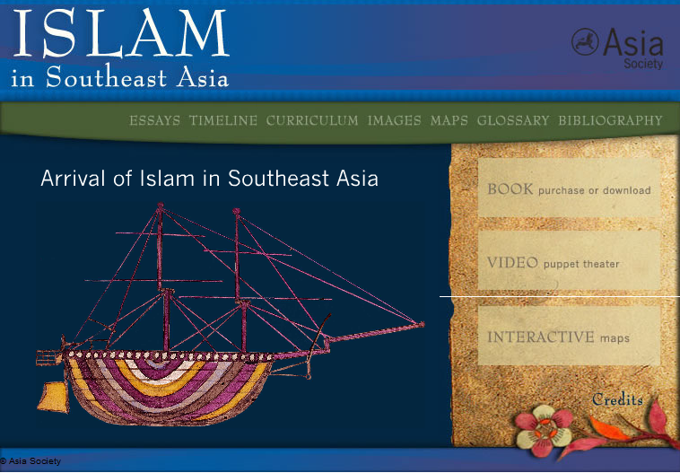
Asia Society: Islam in SE Asia
Interactive website with teaching materials, lesson plans, and a variety of resources for use in schools and colleges
http://sites.asiasociety.org/education/islam_in_seasia/index.htm
Notes:
And last but by no means least, an excellent resource for school and college students, and as a general introduction to the study of Islam in Southeast Asia

